Slide 1
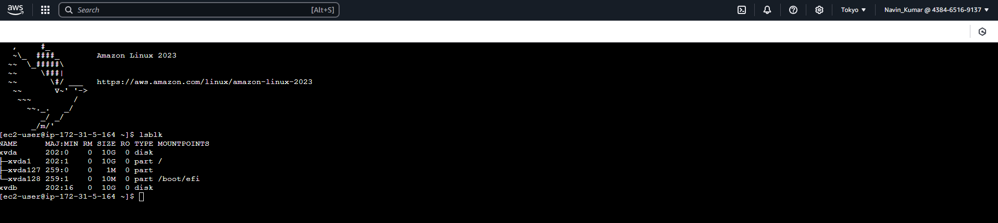

Slide 2
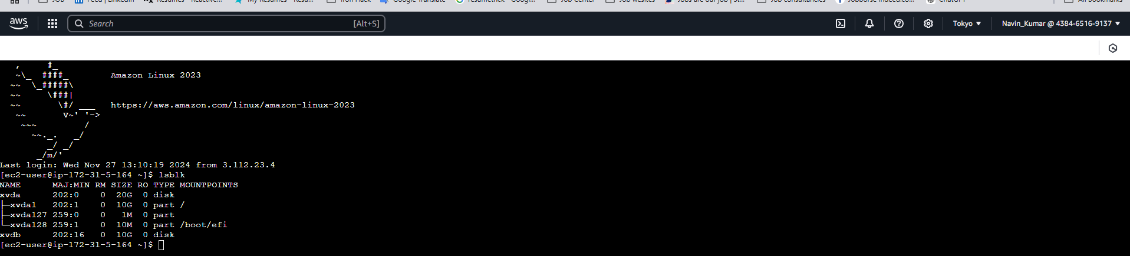

Slide 3
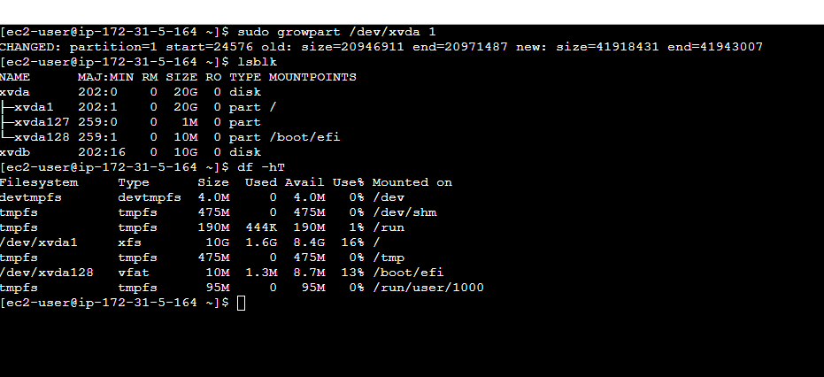

Slide 4
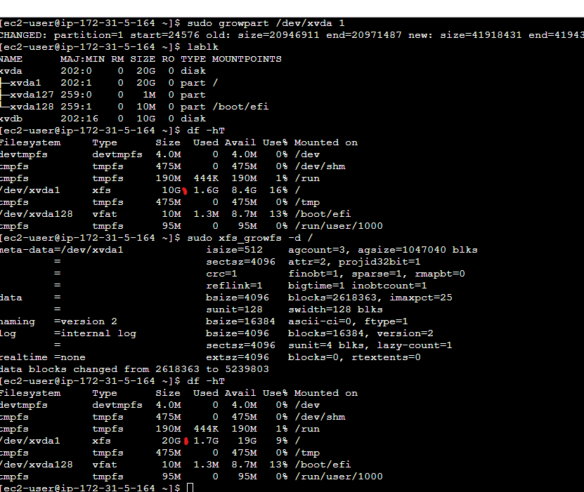

Slide 5
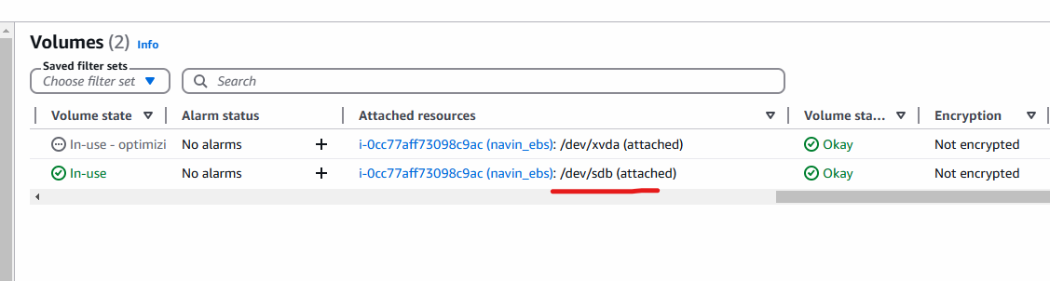
The command xfs_growfs -d / is used to expand an XFS filesystem
to use all available space on its underlying block device.
Here's a detailed explanation:
The growpart command is a utility used in Linux to resize a partition to fill its containing block device. This is particularly useful when you
expand a virtual machine's disk or a physical device and need to adjust the partition to use the newly available space.
The df -hT command in Linux displays information about filesystems, including their type, usage, and mount points,
in a human-readable format. Here's a detailed breakdown
The lsblk command is a utility in Linux used to display information about block devices.
Block devices are storage devices that support reading and writing data in fixed-size blocks, such as hard drives,
SSDs, and USB drives. The lsblk command is particularly useful for viewing details about disks and their partitions.

